Slide 1
RTP: A Transport Protocol for
Real-Time Applications
RFC 1889
H. Schulzrinne, GMD Fokus, S. Casner, R. Frederick, V. Jacboson

Slide 2
Introduction
Internet standard for real-time data
  Interactive audio, video, and simulation data
Primarily designed for multi-user multimedia conference
  Session management
  Scalability considerations
Provides end-to-end transport functions for real-time applications
  Payload type identification
  Sequence numbering
  Timestamping
  Delivery monitoring

Slide 3
Introduction – cont.
Containing two closely linked parts: data + control
  RTP: Real-time transport protocol
    Carry real-time data
  RTCP: RTP control protocol
    QoS monitoring and feedback
    Session control
Architecture
Applications
RTP & RTCP
Other transport and network protocols | UDP
 | IP

Slide 4
Introduction – cont.
Independent of the underlying transport and network layers
Does NOT provide timely delivery or other QoS guarantees
  Relies on lower-layer
Does NOT assume the underlying network is reliable and delivers packets in sequence
  Use sequence number

Slide 5
Introduction – cont.
  New style: Application level framing and integrated layer processing
    Often be integrated into the application rather than a separate layer
    Deliberately not complete – Application could add or tailor when needs
    Complete specification of RTP for particular application needs other documents
      Profile, payload format specification document

Slide 6
RTP use scenarios
Simple multicast audio conference
    A multicast address and two UDP ports (for RTP and RTCP ), assigned and distributed by mechanisms beyond the scope of RTP
    Speaker send:
    Receiver play out audio data according to RTP header
    Sender/receiver periodically multicast report by RTCP
      Who is participating?
      How well is the audio quality?
IP header | UDP header | RTP header | Audio data

Slide 7
RTP use scenarios – cont.
Audio and video conference
  Two RTP sessions, one for audio and the other for video
  User can participate audio, video or both
  No direct coupling at RTP level except a user use the same name in RTCP packets for both audio and video

Slide 8
RTP – packet format
V | P | X | CSRC count | M |  | Payload type | Sequence number (16 bits)
Timestamp (32 bits)
Synchronization source (SSRC) id. (32 bits)
Contributing source (CSRC) id. (0~15 items, 32 bit each)
Header extension (optional)
Payload (real time data)
 |  |  |  |  | Padding (size x 8 bits) |  |  | Padding size (8bits)
Fixed header
optional header
optional
Version (V, 2bits): =2
Padding(P, 1bit): If set, last byte of payload is padding size
Extension(X, 1bit): If set, variable size header extension exists

Slide 9
RTP - header
CSRC count (4 bits): number of CSRC id.
Marker (1 bit): defined in profile, mark significant event
Payload type (7 bits): Audio/Video encoding scheme
Sequence number: random initial value, increase by one for each RTP packet; for loss detection and seq. restoration
SSRC: identify source; chosen randomly and locally; collision needs to be resolved
CSRC list: id. of contributing sources, inserted by mixer

Slide 10
RTP – header - timestamp
Reflects sampling instance of the first octet in payload
Derived from a clock increments monotonically and linearly
Clock frequency depends on data type; specified in profile
Random initial value
Example: CBR audio, clock increment by 1 for each sample.
If block have 160 samples, timestamp increase 160
Consecutive RTP packets may have same timestamp: Video
Timestamps of consecutive RTP may not increase monotonically: MPEG interpolated video frames

Slide 11
RTP – intra-media synchronization
Reconstruction with playout buffering
Desired: all
packets have the
same delay
t
Packets sent
d1
d1+y
Packets received
h
h-y
Packets playout
t

Slide 12
RTP – cont.
Multiplexing
  Provided by transport address (network address + port number)
    Teleconference with Audio and Video
      A and V are carried in separate RTP session
      Each session has two transport address
Profile-specific modification
  Marker bit
  Header extension starts at payload section

Slide 13
RTCP – RTP control protocol
Periodically transmit report to all participants; Functions of RTCP:
  Provide QoS feedback
  Carry persistent id. - Canonical name (CNAME)
    Track a user if SSRC changed (confliction, etc.)
    Associate multiple streams from a user – A and V
  Control the rate of RTCP packets – scalability
  Convey minimal session control information
    Not enough for complicated session control requirements

Slide 14
RTCP - types
Sender report (SR): statistics from active sender
Receiver report (RR): statistics from participants except active sender
Source description item (SDES): includes CNAME
BYE: indicates end of participation
APP: application specific functions

Slide 15
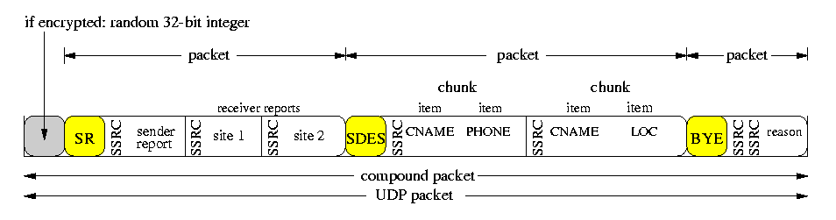
RTCP – compound packet
RTCP packets have a length field in header; aligned to 32 bits --- stackable
Sent in a compound packet of at least 2 RTCP packets; example:

Slide 16
RTCP – sender report (SR)
SSRC: identify sender
Sender info. block:
  NTP timestamp: sent time (wallclock time or other)
  RTP timestamp: corresponding to NTP but in formats of RTP data packet timestamp; used for intra&inter media synchronization
  Sender’s packet count & octet count
Multiple report blocks, each block has
  SSRC_n, fraction lost, number of lost
  Highest sequence number received
  Inter-arrival jitter, LSR, DLSR

Slide 17
RTCP – RR & SDES
Receiver Report (RR): Similar to SR but without sender information block
RTCP Source Description packet (SDES)
  Containing CNAME, mandatory
    Constant for a user, unique among all users
    Providing binding across multiple medias sent by a user
    Example: poly_id@utopia.poly.edu;
    7182603384

Slide 18
RTCP – round trip time calculation
t1
t4
sender
SR
RR
receiver
DLSR
t2
t3
SR packet contains: NTP (=t1)
RR packet contains: Last SR timestamp (LSR=t1), Delay Since Last SR (DLSR=t3-t2)
Roundtrip time = t4 - t3 + t2 - t1 = t4 – (t3-t2) –t1
= t4 – DLSR - LSR

Slide 19
RTCP – transmission interval
Designed to scale from a few to thousands users
  Problem: RTCP traffic is not self-limiting; grows linearly with number of user if sent in constant rate
  Solution: limit control traffic to a small and known fraction of total session traffic, 5% suggested
    Small: efficiency Known: resource reservation
Characteristics of transmission interval calc. algorithm
  Sender occupies 25% of control traffic bandwidth
  Calculated interval should be no less than 5 seconds
  Trans. interval randomly varied between a range
  Dynamic estimate average compound packet size

Slide 20
RTP Mixer and Translator
Mixer
64 kbps
8 kbps G.729
Mixer
64 kbps
64 kbps
Translator
firewall
8 kbps G.729
Translator
64 kbps PCM
Translator

Slide 21
Other issues
Collision detection and resolution
  Two sources use the same SSRC
Loop detection
Inter-media synchronization
Security
Header compression – RFC 2508
  IP+UDP+RTP = 40 bytes, large overhead

